Slide 1
INSPIRE SERIOUS GAME
Scope - Objectives
Key points

Slide 2
The main aim of INSPIRE SERIOUS GAMES is to INSPIRE young people to
engage Social Entrepreneurship by identifying the key role they
can play in a team.

Slide 3
1. Promote entrepreneurship education and social entrepreneurship among young people (18-24)
B. Support young people to identify their skills and competences, in order to develop them more or acquire new for succeeding in developing sustainable Social Enterprises
OBJECTIVES
C. Enhance acquisition of key skills and competences in Social entrepreneurship, SDGs, Self-awareness, Social Media from young people

Slide 4
1. The INSPIRE serious game will be a combination of all the acquired knowledge and material of O1, O2, and O3
2. The game will challenge the players to participate in a social initiative addressing specific SDGs and overcoming existing challenges of young or/and old entrepreneurs.
OBJECTIVES
3. While playing the personality, skills and characteristics of the player will be assessed in order to give back feedback on the role he can take in a team of young envisionairs and how to develop their skills.

Slide 5
Description of the game
In the beginning of the game the players select their characteristics (nickname,age, nationality, etc).
Then the player is transferred to an environment where he or she has to solve a problem based on SDGs.
The player should identify the problem, find an innovative solution, create a vision in the team, plan a business model, network, find resources, disseminate the cause and evaluate the impact.
During the game the player will meet challenges on these topics and he/she has to choose between 2 different options to create his/her unique story of success.
The different options that players have are based on existing assessment tools explained in O2, while the business challenges and social media tactics are based on O3.
At the end of the game the player will receive an assessment on his/her skills and competences as well as his/her personality characteristics and roles within a team.

Slide 6
INNOVATION of the GAME
It focuses on Social Entrepreneurship
It addresses the needs of young people in terms of "fun", learning outputs and psychometric assessment
It is both a game that help young people engage with Social Entrepreneurship, learn about business and at the same time identify their skills and competences
The assessment it gives back can lead young people to the collaboration with the right team for design and implement a Social idea.

Slide 7
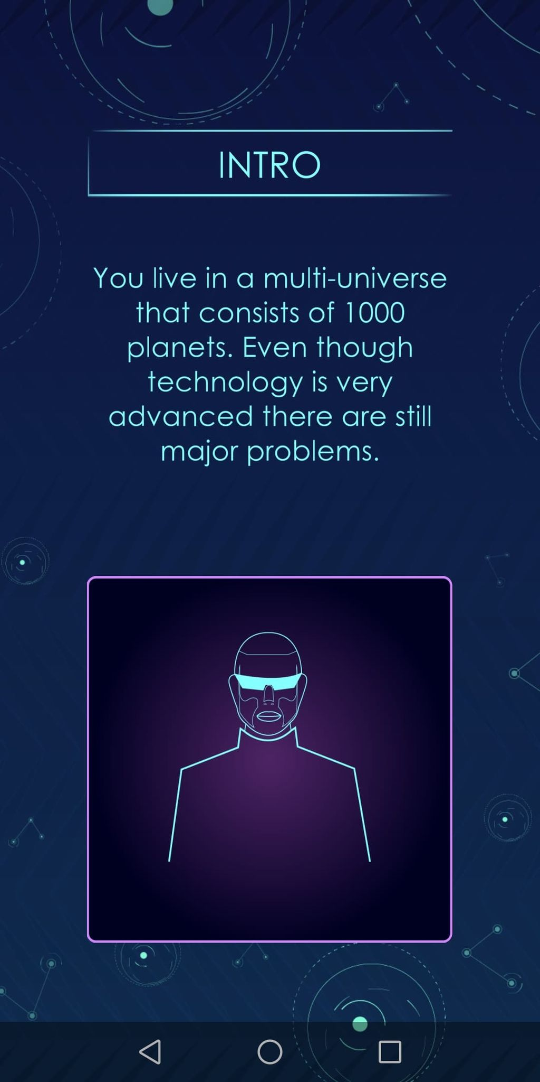
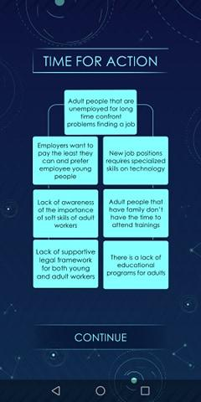
The key points of Level 1 are:
Introduce you to the game
Introduce you to Sustainable Development Goals (SDGs)
Introduce you to the environment of social-startups which can help towards SDGs
Help you understand how to analyze a problem and get into the root of it
Introduce you to the tool of “Why why tree” for the analysis of a problem
Help you understand how you can find the strategy you can follow based on your resources for solving the problem
Give you tips on how to exploit the
“Why why tree”
LEVEL 1

Slide 8
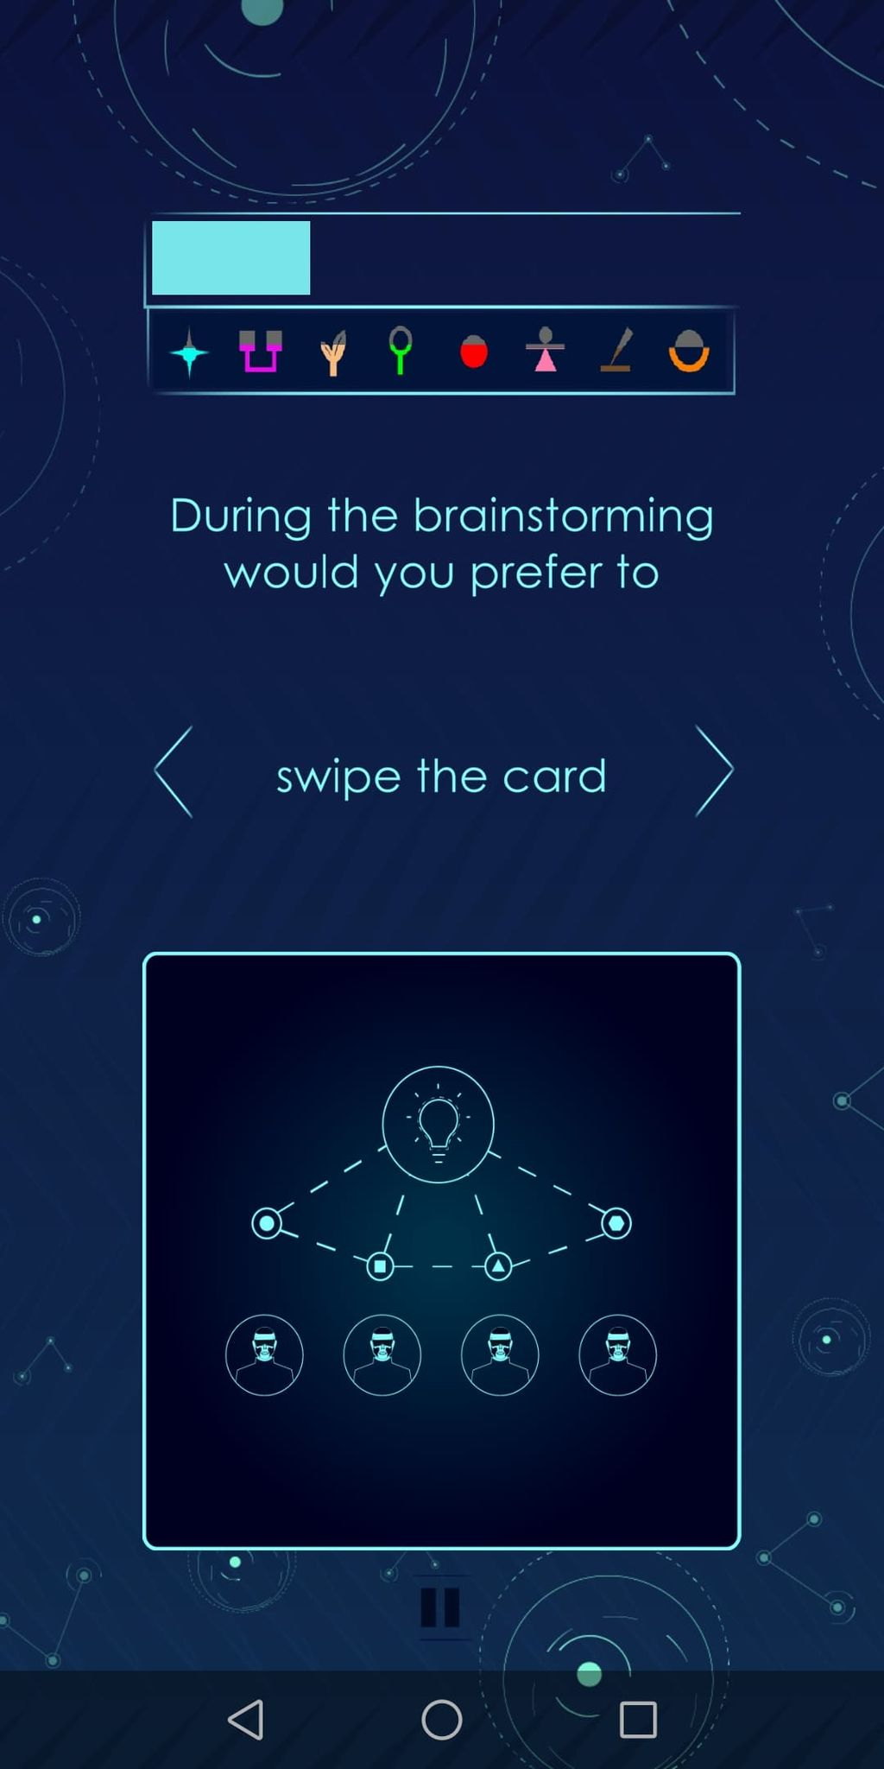
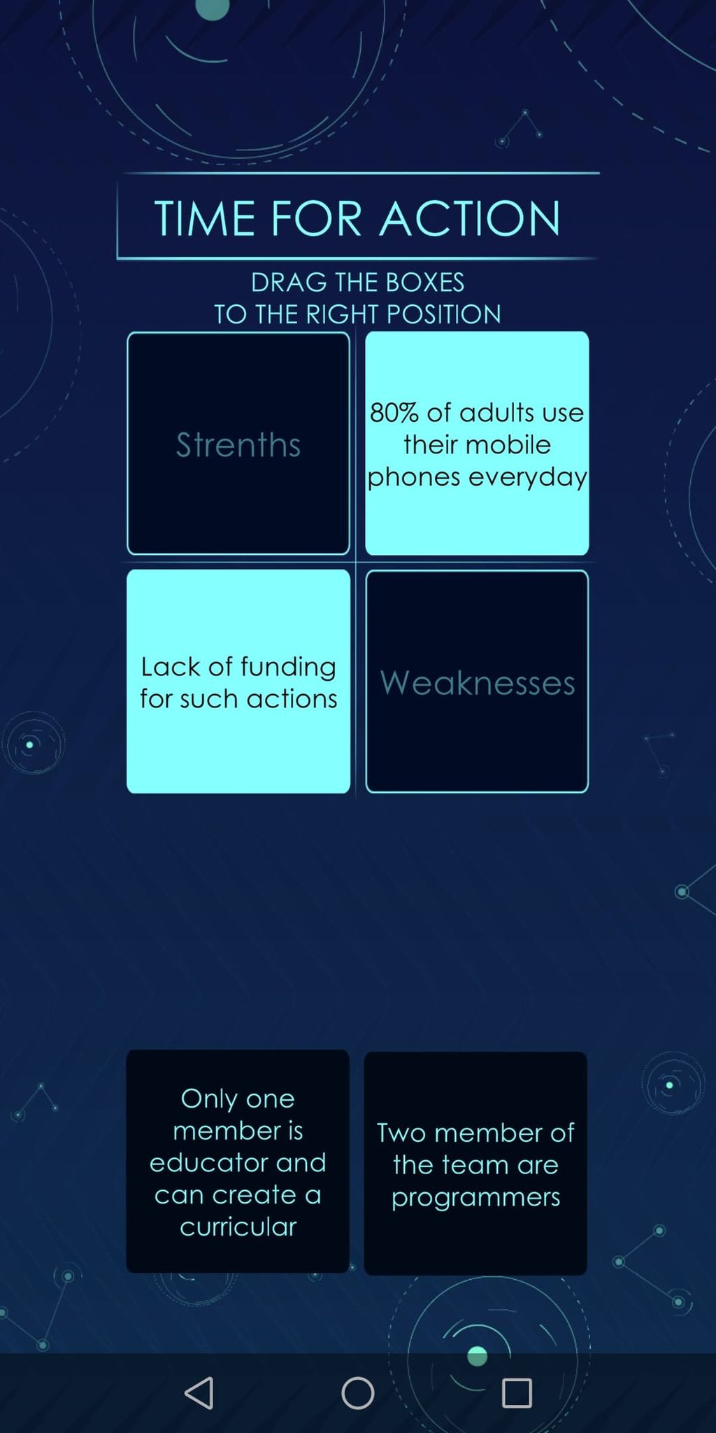
The key points of Level 2 are:
Introduce you to different ways of brainstorming for developing an innovative idea that solve a problem
Help you understand the meaning of innovation in a social startup
Introduce you to the tool of “SWOT analysis” for evaluating an idea based on the team strengths and weaknesses and outside opportunities or threats
Help you understand how you can use SWOT analysis in other situations
LEVEL 2

Slide 9
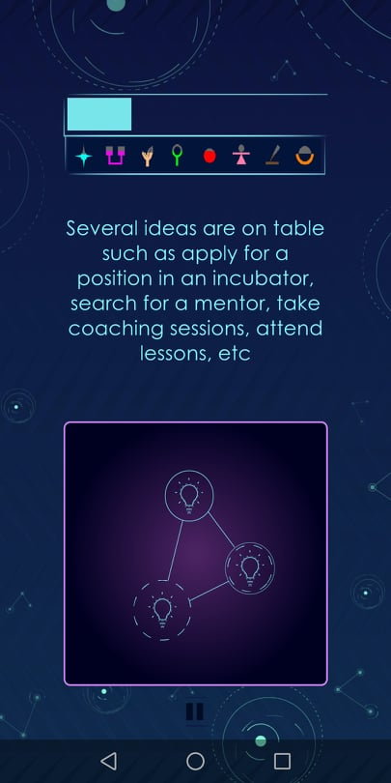
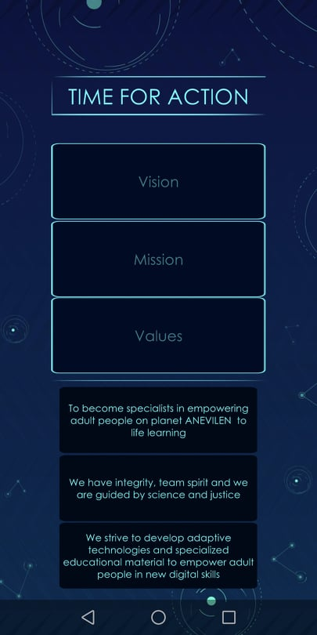
The key points of Level 3 are:
Introduce you to different ways of building the capacity of the members of the founding team: mentoring, incubators, accelerators, trainings, workshops, e-courses, networking, studying in a uni etc.
Introduce you to the more up-to-date argo of Entrepreneurship: incubator, accelerator, mentor.
Introduce you to the tool of “Vision-Mission-Values boar” for developing a structured vision for your social startup
Help you shape your Vision and Mission for your innovative ideas
LEVEL 3

Slide 10
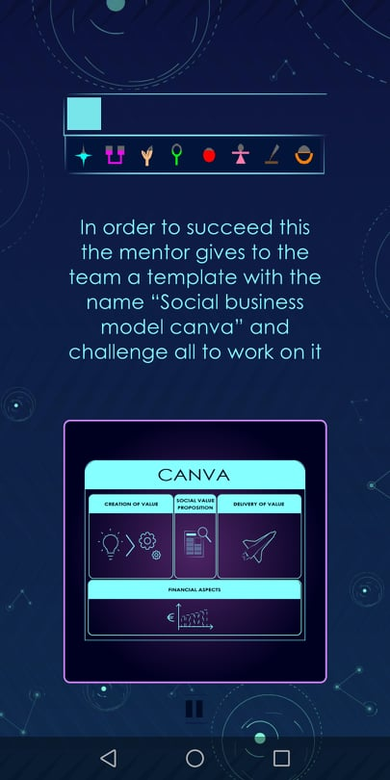
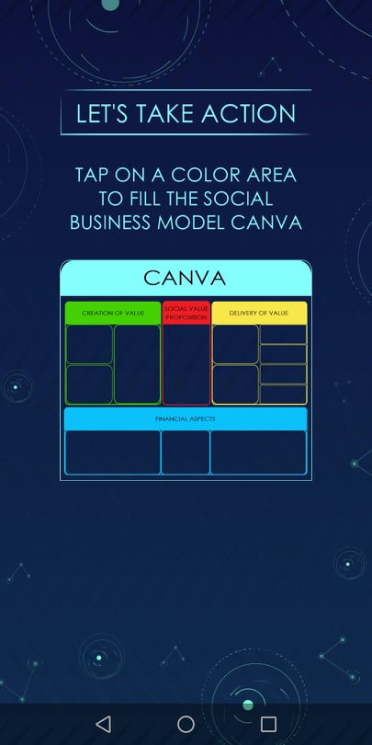
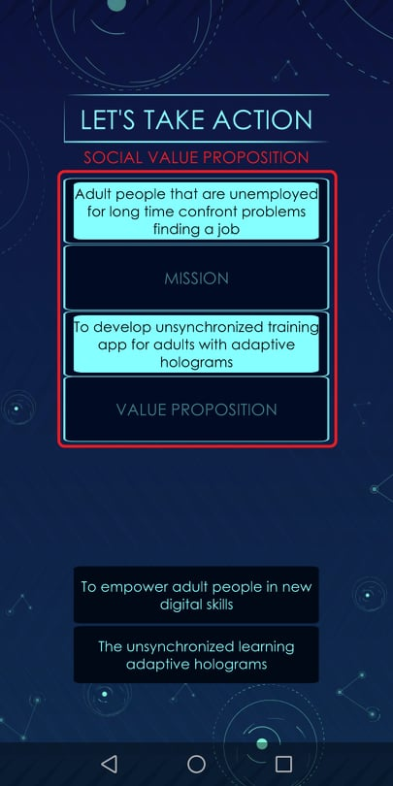
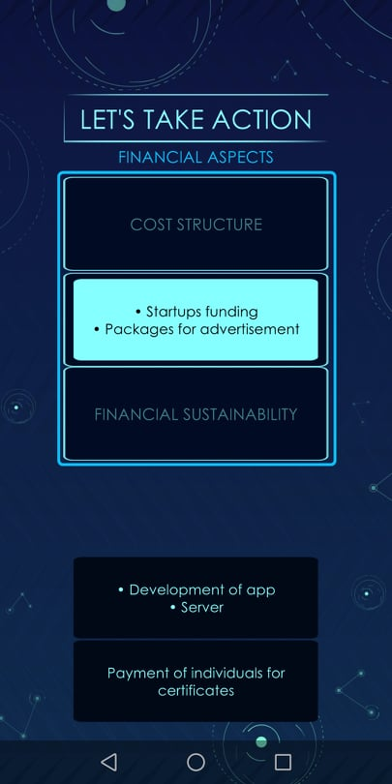
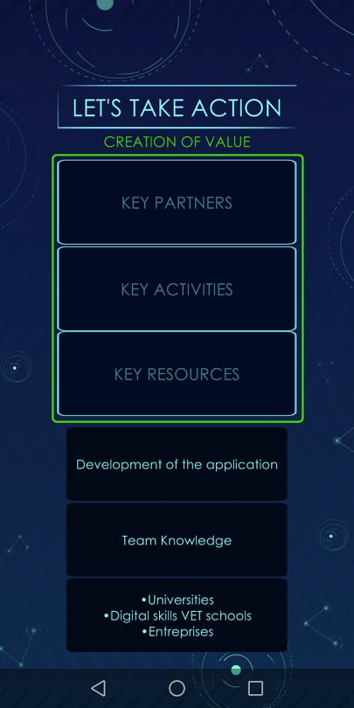
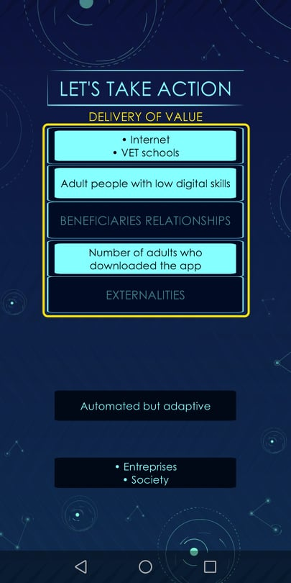
The key points of Level 4 are:
Introduce you to Business models for Social enterprises
Help you understand the importance of having a plan before you start your enterprise as well as the importance of evaluating your resources and developing a plan based on them
Introduce you to the tool of “Social Business model Canva” for developing a structured plan for your social startup
Help you understand how to develop a plan through completing the “Social Business model Canva”
Give you tips for this important procedure!
LEVEL 4

Slide 11
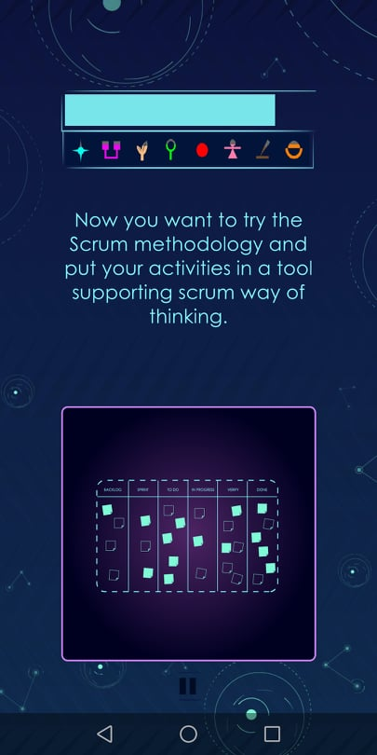
The key points of Level 5 are:
Introduce you to difficulties and challenges that founding members can face during the first years of the initiation of the startup
Help you find ways to overcome those difficulties and challenges
Introduce you to the tools of “Gantt chart” and “Scrum board” as well as to the different Management approaches (eg. PMI, Waterfall, Scrum)
Help you understand the pros and cons of some of the most known management approaches and find out which one is better for your team
LEVEL 5

Slide 12
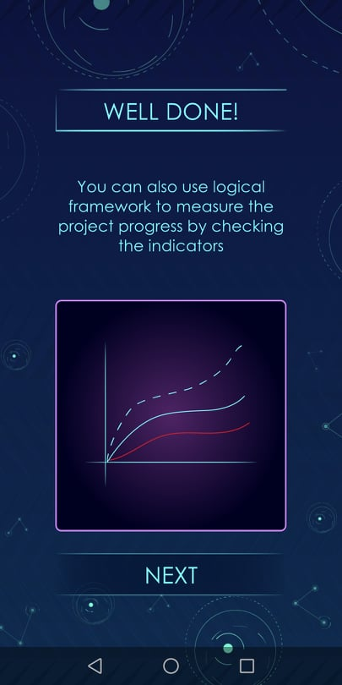
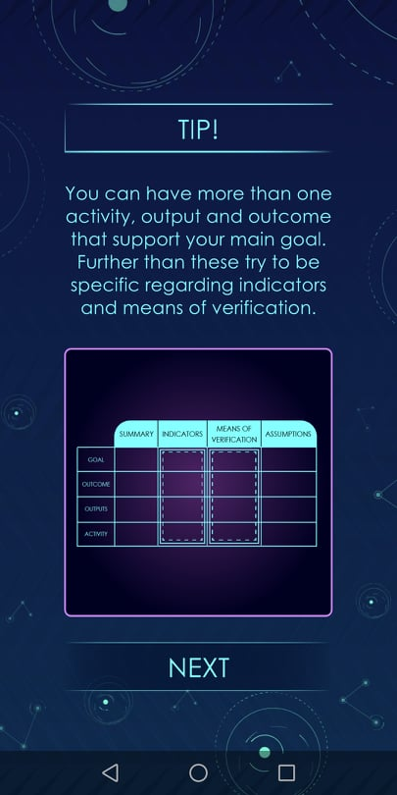
The key points of Level 6 are:
Underline you the importance of developing a sustainable financial plan for your social startup
Help you find ways to develop a sustainable financial plan as well as develop a plan of actions that lead to the results and objectives of your social initiative
Introduce you to the tool of “Logical framework” which is a tool that many foundations and applications asks for applicants asking for funding
Help you understand how to create a Logical framework for your startup
Give you some tips on other ways you can use the Logical framework during the development of your activities
LEVEL 6

Slide 13
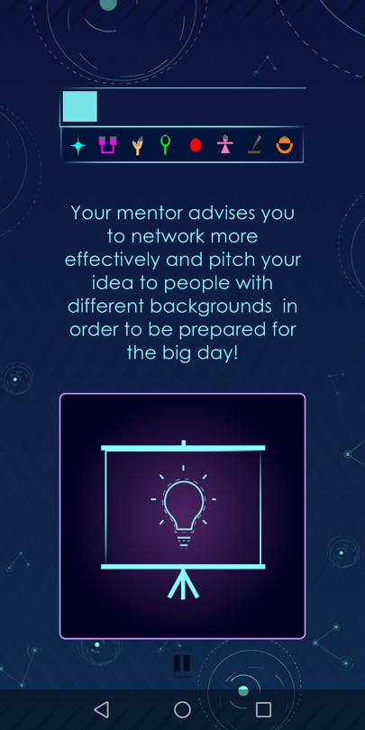
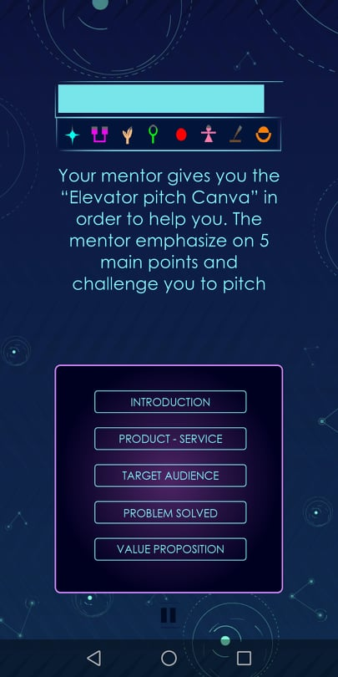
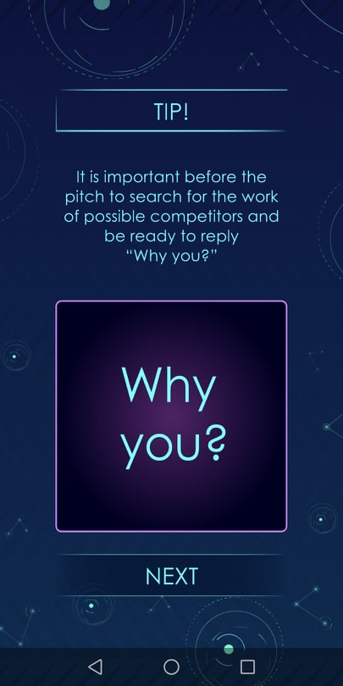
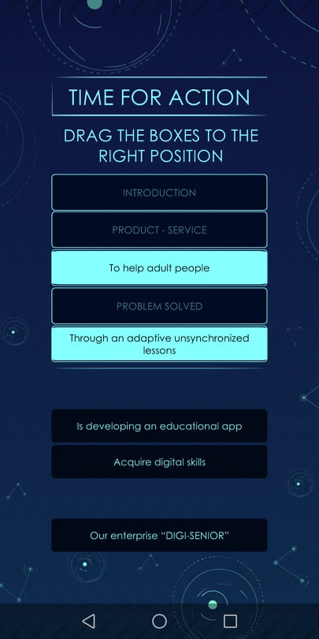
The key points of Level 7 are:
Underline you the importance of networking with possible investors or with other companies, startups, volunteers, etc.
Help you find ways to do networking
Introduce you to the tool of “Elevator Pitch” which can help you present your idea in a structured way in a short time so that people can easily engage it
Underline the importance of answering the question “Why you?” which is very important when it comes to selecting you over other ideas or startups
LEVEL 7

Slide 14
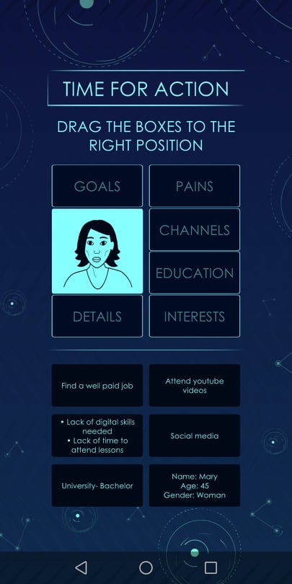
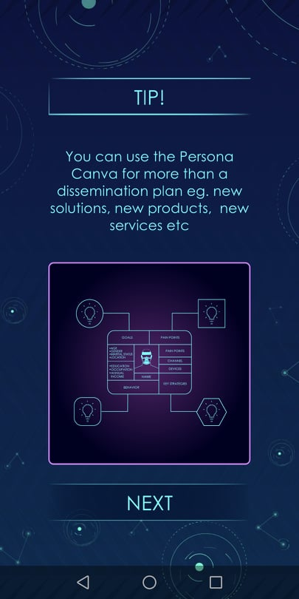
The key points of Level 8 are:
Underline you the importance of communicating the cause of the startup as well as the impact and results
Help you understand the meaning of dissemination
Help you use effectively the social media for the cause of your social startup
Introduce you to the tool of “Persona Canva”
Give you tips on how you can use this tool for both developing social media posts as well as developing activities and products in your social startup
LEVEL 8

Slide 15
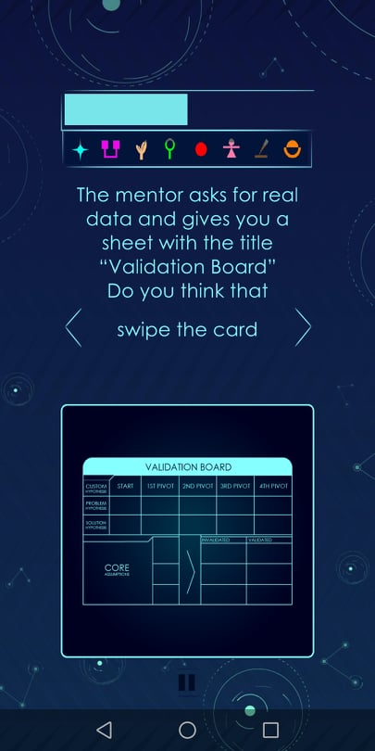
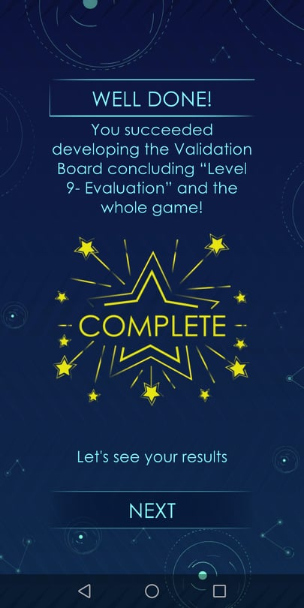
The key points of Level 9 are:
Underline you the importance of evaluating the impact of the social startup
Underline the importance of capitalization of the knowledge learned during the years or projects
Help you become more agile and make pivots in order to find your place in the innovation and economy
Introduce you to the tool of “Validation board”
LEVEL 9

Slide 16
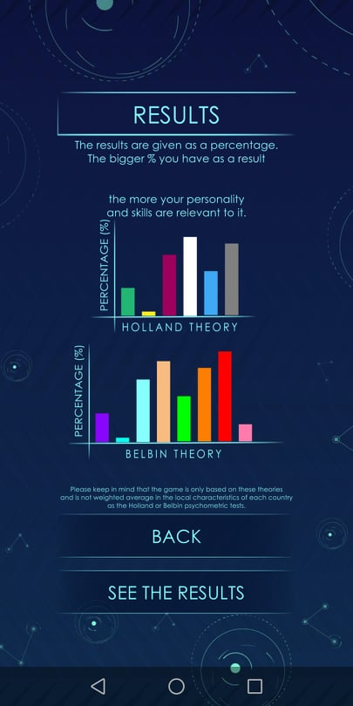
In the end of the 9th Level the game gives you results on your personality, skills and role you can play in a team
The results of the game are divided in two categories:
Results based on Holland theory which are more skills oriented and help you understand your skills and the key characteristics of your personality
Results based on Belbin theory which are more oriented to roles you can play as a member in a team
It is important to underline here that the game is based on existing tools but it is not weighted on the local characteristics of different populations
RESULTS

Slide 17
INSPIRE
2019-3-EL02-KA205-005215
THANK YOU!!
This presentation is related to the Project made by the beneficiaries jointly or individually in any form and using any means shall indicate that it reflects only the authors view and the National Agency and the European Commision are not responsible for any use that may be made of the information it contains.

